Slide 1
Tuesday
August 25th, 2015
By the end of the day, YOU will be able to:
Solve problems related speed and velocity.
Graph distance vs time data
Use the slope of a distance vs time graph to find speed
Starter:
What is the equation for speed? What does it look like in the triangle form?
A train travels 225 km East in 2.5 hrs. What is the trains average velocity?
Suppose you ride your bicycle to the library traveling at 0.5 km/min. It takes you 25 mins to get the library. How far did you travel?
A person in a kayak paddles upstream at an average speed of 4 km/hr. How long would it take her to travel 16 km?
And answer a question like this:
If a distance vs time graph has a slope of 0, what has happened?
Agenda:
Complete Speed Lab
Position vs Time
Speed/Velocity Practice
8-10 minutes

Slide 2
Distance vs Time
When plotting distance vs time graphs, time is always plotted on the x-axis.
Distance is plotted on the y axis

Slide 3
Objects at Rest
If an object is not moving, a horizontal line is shown.

Slide 4
Object at a constant speed
If an object is moving at a constant speed, it means it has the same increase in distance in a given time.

Slide 5
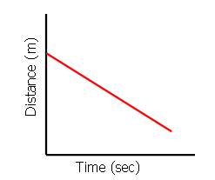
Just like the previous graph, this graph shows an object moving with constant velocity

Slide 6
Comparing Objects
Both of the lines in the graph show that each object moved the same distance, but the steeper dashed line got to that distance before the other one.

Slide 7
Summary
A distance – time graph tells us how far an object has moved with time.
  The steeper the graph, the faster the motion.
  A horizontal line means the object is not changing its position– it is at rest

Slide 8
Explain what is happening for each segment. (An airplaine descending for landing.)

Slide 9
John left his home and walked 3 blocks to his school.
What is one possible interpretation of the section of the graph from point b to point c?

Slide 10
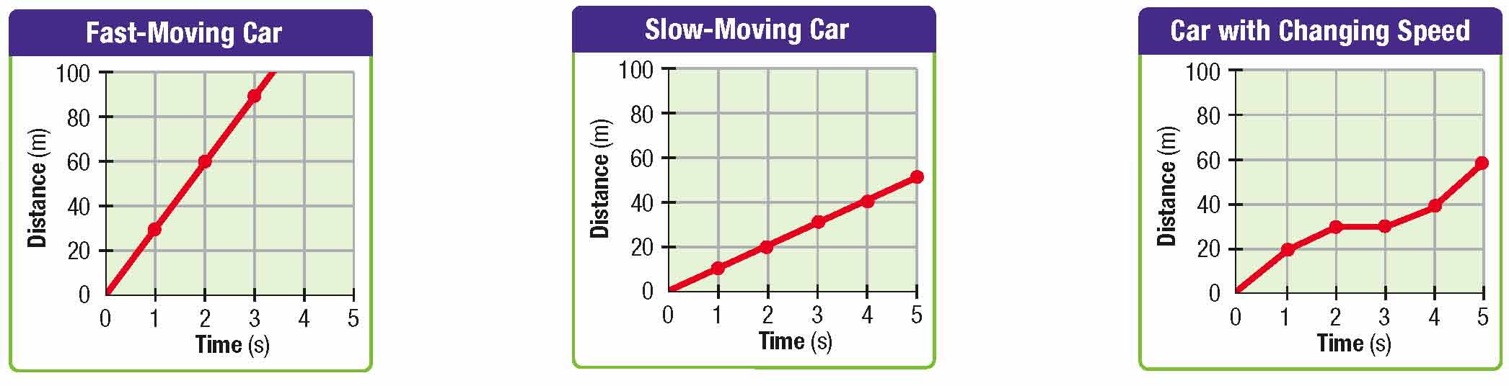
Calculating Speed
For a distance vs time graph, the speed of the object is equal to the slope of the line.
Slope= y₂-y₁
x₂-x₁
Sometimes called the rise over the run.

Slide 11
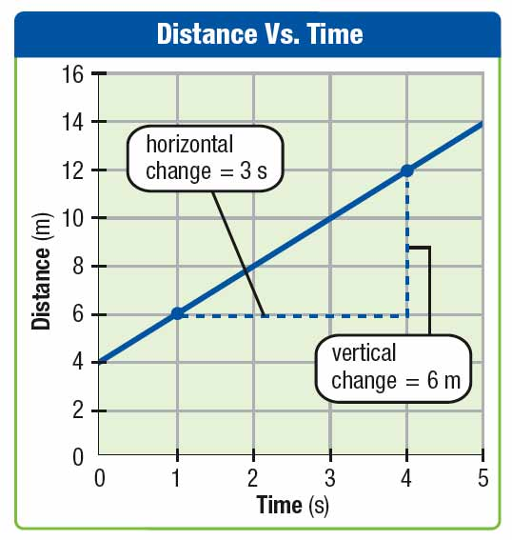
Calculating Slope

Slide 12
Speed

Slide 13
Find the speed.

Slide 14
Slope
Find the speed for each segment of the graph.

Slide 15
Plotting Distance vs Time
Time (s) | Distance (m)
0 | 0
1 | 1
2 | 2
3 | 3
4 | 4
5 | 4
6 | 4

