Slide 1
August 12, 2016
After today, you should be able to…
Identify proper tools for measurement
Convert between metric units
Starter-
What is the difference between a dependent and an independent variable?
Which group gets the variable that is being tested?
Agenda
MUST DO:
Starter
Complete Scientific Method Case Studies (2nd & 4th)
Scientific Method Writing Assignment(2nd & 4th)
Create a unit of measurement. (1st)
Begin Measurement (1st)
Reminders: Start bringing calculators and composition notebooks to class. Remember that parent letters are due by Friday.
Homework: NONE

Slide 2
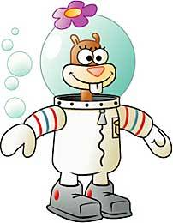
Read the information below and then answer the questions.
SpongeBob loves to grow flowers for his pal Sandy, who loves big, colorful flowers. He found a new brand of seeds coated with a special “booster” fertilizer that said it would produce huge flowers. He planted 5 of the new seeds in one container and 5 of the old brand of seeds in another container. He placed both containers on a sunny windowsill and watered them every day. He measured the diameter of each flower, which is shown in the chart.
Old Seeds | 10 cm | 12 cm | 14 cm | 6 cm | 8 cm
New Seeds | 8 cm | 14 cm | 10 cm | 12 cm | 16 cm
Which group was the control?
The seeds without the booster fertilizer
2. What is the independent variable?
Booster fertilizer on the new seeds
3. What is the dependent variable?
Size or diameter of the flower
4. What is the average diameter for each group?
Old = 10 cm, New = 12 cm
5. Which seeds are the best for big flowers?
New seeds w/ the booster

Slide 3
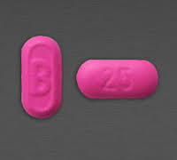
Class Case Study
Diphenhydramine is a new drug being studied as a treatment for shortness of breath. In a study with 400 people, 200 people received diphenhydramine pills and 200 people received sugar pills as placebos. The patients treated with diphenhydramine showed an increase in the distance they could walk before they became short of breath.
state the hypothesis to be tested in the experiment
identify the dependent variable in the experiment
state whether the data supports or fails to support the hypothesis and justify your answer

Slide 4
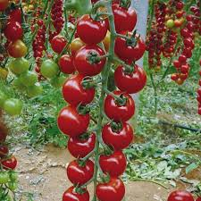
Experiment Writing Assignment
You have been assigned to design an experiment to determine the effects of light on the growth of tomato plants. In your experimental design be sure to:
State the problem and one hypothesis to be tested
Identify the independent variable in the experiment
Describe the type of data to be collected
Describe how the experimental group should be treated differently than the control group (variables and constants).

Slide 5
August 15, 2016
After today, you should be able to…
Identify proper tools for measurement
Convert between metric units
Starter
Reminders: Start bringing calculators and composition notebooks to class. Remember that parent letters are due by Friday.
Homework: NONE

Slide 6
Measurement

Slide 7
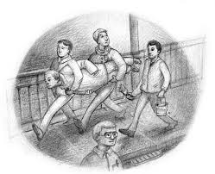
Create a Unit of Measurement
OBJECTIVE
In this experiment, you and your group will be creating a unique unit of measurement based on the length of an object in the classroom. You will then figure out how to measure objects around the room and in the building using your new unit of measurement.
PROCEDURE
Pick an item to use as your unit of measurement. Record its name.
Using the item, measure each of the items listed below
Name of your new unit of measurement: ____________________
The height of the tallest person in your group: ____________________
Height of your desk in your units: ____________________
Length of the board units: ____________________
Distance from my doorway to my desk: ____________________

Slide 8
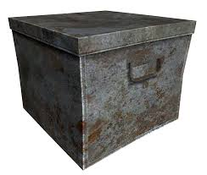
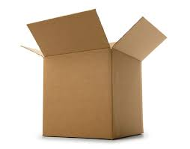
Purpose of Measurement
To describe quantitatively specific aspects of an object.
If someone is telling you about a box, it helps to know some of the boxes measurements.

Slide 9
Tools Used For Measuring
Volume
Graduated Cylinder, Beaker, Flask
Length
Meterstick, ruler, tape measure
Mass
Triple beam balance, scale
Time
Stopwatch or clock
Force
Spring Scale
Temperature
Thermometer

Slide 10
SI Units
International System of Units or SI units
So that everyone had the same, reliable measurement system.
Previously called the Metric System
SI Units
Length
Meter
Volume
Liter
Mass
Gram
Temperature
Kelvin and Celsius

Slide 11
August 14th, 2015
DLR-
Convert between metric units.
Starter-
List the basic unit of measurement for each:
Mass c. Length
Volume d. Temperature
Identify what each tool is used to measure.
Graduated cylinder d. ruler
Spring scale e. thermometer
Triple beam balance f. stopwatch
Why is it important for scientists all around the world to use the same system of measurements?
Agenda
MUST DO:
Starter
Lab Safety Quiz
Metric Conversions Notes/Classwork
Group Board Races
Bill Nye Measurement Video (if time)
Reminders: Start bringing calculators and composition notebooks to class. Remember that parent letters are due by Friday.
Homework: NONE

Slide 12
Lab Safety Quiz
Lab Safety Quiz #1
Answer the following questions by writing out TRUE or FALSE in the blank. If you only put T or F, it will be wrong:
______________ You should only wear safety glasses in the lab when you feel like it.
______________ A good procedure for trying to identify a substance in lab is to take a big whiff of it and see what it smells like.
______________ If there is a fire in the lab, you should notify the teacher immediately and NOT try to put it out yourself.
______________ It is okay to eat and drink in the lab.
______________ If you get bored and feel like starting up your own little experiment in lab, that’s okay, go right ahead.
______________ You should never pick up broken glass with your bare hand.
______________ When you will be handling hazardous chemicals, you only need to use gloves every third Tuesday after a full moon.
Answer the following questions in complete sentences
What does it mean to waft? Why is it important?

Slide 13
Mneumonics
Kill Hector Dead Mother Doesn’t Care Much
King Henry Died By Drinking Chocolate Milk
K H Dk B D C M

Slide 14
Prefix | Symbol | Meaning | Multiple of base unit
kilo- | k | thousand | 1,000
hecto- | h | hundred | 100
deca- | dk | ten | 10
deci- | d | tenth | 0.1
centi- | c | hundredth | 0.01
milli- | m | thousandth | 0.001
micro- | µ | millionth | 0.000001

Slide 15
Ladder Method
1
2
KILO 1000 Units
3
HECTO 100 Units
DEKA 10 Units
DECI 0.1 Unit
CENTI 0.01 Unit
MILLI 0.001 Unit
Meters Liters Grams
How do you use the “ladder” method?
4 km = _________ m
1st – Determine your starting point.
2nd – Count the “jumps” to your ending point.
3rd – Move the decimal the same number of jumps in the same direction.
Starting Point
Ending Point
How many jumps does it take?
4.
__.
__.
__.
= 4000 m
1
2
3

Slide 16
Conversion Practice
Try these conversions using the ladder method.
1000 mg = _______ g 1 dL = _______ mL 160 cm = _______ mm
14 dkm = _______ m 109 g = _______ kg 250 hm = _______ km
Compare using <, >, or =.
56 cm 6 m 7 g 698 mg

Slide 17
Metric Conversions Classwork
1.467 km to m
45 g to cg
2345.2 mm to hm
45678 mm to dkm
0.00235 hL to dL
12 dkg to cg

Slide 18
1,467 m
4500 cg
0.02345 hm
4.5678 dkm
2.35 dL
12,000 cg

Slide 19
2000 mg = ______ g

Slide 20
104 km = _______ m

Slide 21
480 cm = _______ m

Slide 22
5.6 kg = ________ g

Slide 23
8 dkm = ________ hm

Slide 24
5 L = _______ mL

Slide 25
198 cg = _____ hg

Slide 26
75 mL = _____ L

Slide 27
50 cm = _____ m

Slide 28
5.6 m = _____ cm

Slide 29
16 cm = ________mm

Slide 30
2500 m = _______ km

Slide 31
65 dg = _________ mg

Slide 32
6.3 cm = _______ mm

Slide 33
120000 hg = ________ mg

Slide 34
Metric Conversion Challenge
Write the correct abbreviation for each metric unit.
1) Kilogram _____ 4) Milliliter _____ 7) Kilometer _____
2) Meter _____ 5) Millimeter _____ 8) Centimeter _____
3) Gram _____ 6) Liter _____ 9) Milligram _____
Try these conversions, using the ladder method.
10) 2000 mg = ______ g 15) 5 L = _______ mL 20) 16 cm = _______ _mm
11) 104 km = _______ m 16) 198 g = _____ kg 21) 2500 m = _______ km
12) 480 cm = _______ m 17) 75 mL = _____ L 22) 65 g = __________ mg
13) 5.6 kg = ________ g 18) 50 cm = _____ m 23) 6.3 cm = ________ mm
14) 8 mm = ________ cm 19) 5.6 m = _____ cm 24) 120 mg = ________ g

Slide 35
Word Problems
There is a jar on the cabinet by the refrigerator. Savannah pours two hundred eight milliliters of water in the jar six times to fill it, how many liters of water does it take to fill the jar?

Slide 36
Eric’s father asked an engineer to survey the field behind his house. He wanted to plant some apple and pear trees there. According to the survey, the field is thirty-eight meters long and seventeen meters wide. What is the perimeter of the field in kilometers?

Slide 37
`
Dylan is the best athlete in our school. He plays football, basketball, and baseball and does the pole vault for the track team. He can vault up to five meters and seventy-three centimeters. If he would like to be able to pole vault up to six and twelve hundredths meters, how many more centimeters does he need to pole vault to reach his goal?

