Slide 1
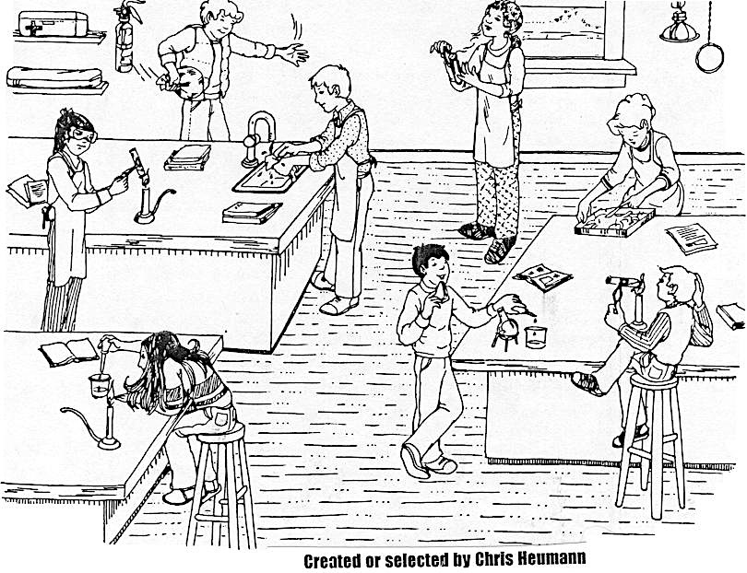
Starter
What are the students in this picture doing wrong?

Slide 2
Wednesday, August 10, 2016
By the end of the day, you will be able to:
Starter:
Starter- Get out a clean sheet of paper and title it “Unit 1 Starters” then answer the questions listed below.
“Hurricane Irene will likely hit NYC, scientists say… New Yorkers prepare for the worst” -The New York Times (8/25/11)
Is it ok to just accept what scientists say?
What reasons do we have to believe them?
Describe the process by which scientists answer questions
And answer a question like this:
How is the scientific method used in everyday life?
Topic: The Scientific Method

Slide 3
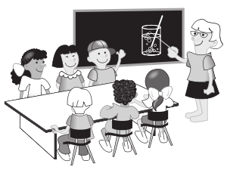
Doing Science
Four students were having a discussion
about how scientists do their work.
This is what they said…
Antoine: “I think scientists just try out different things until something works”
Tamara: “I think there is a definite set of steps all scientists follow called the scientific method”
Marcos: “I think scientists use different methods depending on their question”
Avery: “I think scientists use different methods but they all involve doing experiments”
Which student do you most agree with? Explain why. Also include why you disagree with the other students.

Slide 4
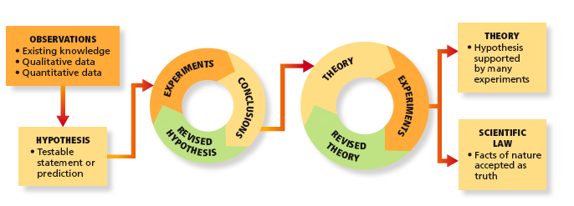
The various parts of the scientific method.
Scientific method:
- a way of solving problems using a systematic approach

Slide 5
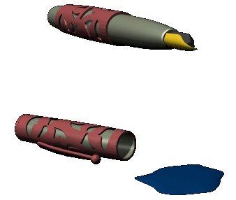
The “Scientific Method”
Step 1 - Identify the problem/ Make an Observation
Write a statement that narrows your research question down to one idea
Something that you notice/wonder
Can be…
* Qualitative: no number involved
Ex. The water is warm
*Quantitative: measured with numbers
Ex. The water is 67⁰C

Slide 6
The “Scientific Method”
Step 2 - Gather information (research)
Look for what has been published before
This does not imply taking previously published work as absolute fact
(skepticism is allowed)

Slide 7
The “Scientific Method”
Step 3 - Make hypotheses (Note: this is the plural of hypothesis)
Hypothesis: a possible explanation for an observation based on Research
Testable predictions
If it is not testable it is not a true hypothesis.

Slide 8
The “Scientific Method”
Step 4 - Test hypotheses one at a time
Experiment: Something that we do to test our hypothesis.
They produce…
Data (new information)
Conclusions (based on data to support or negate hypothesis)
Theory model (explanation for an observation)
Based on tested hypotheses and often change
Natural Law (summary of observed behavior)

Slide 9
The “Scientific Method”
Step 5 - Examine the results for patterns
Evidence that supports (not proves) or disproves your hypothesis
Beware of misleading evidence or evidence that could mean more than one thing
Follow all leads/evidence
Theory model (explanation for an observation)
Based on tested hypotheses and often change
Natural Law (summary of observed behavior)

Slide 10
The “Scientific Method”
Step 6 – Report your findings

Slide 11
The “Scientific Method”
Throughout your work, it is very important to keep complete records
Can’t just throw out results that you don’t like
May look back and find
sources of error

Slide 13
The “Scientific Method”
The Scientific Method can be used to solve any problem
Even to get a date for Friday night
Here's how to do it:

Slide 14
The “Scientific Method”
You cannot solve a problem until you know exactly what it is.
Step 1 – State the Problem
My Problem is - "I need a date for Friday Night".

Slide 15
The “Scientific Method”
What will it take to solve my problem? What do I know, and need to know, about my problem?
Step 2:Research the problem.
Who can I take?
Examine the possibilities.
Eliminate poor choices.
Consider likely choices.

Slide 16
The “Scientific Method”
Propose a possible solution. The simplest solution is often the best solution!
Step 3: Form a hypothesis.
"My date will be ( Name )".

Slide 17
The “Scientific Method”
Perform an experiment to see if your hypothesis is supported.
Step 4: Test the hypothesis.
"Ask ( Name ) for a date Friday Night".

Slide 18
The “Scientific Method”
Data are the results of an experiment.
Step 5: Draw conclusions from the data.
In its simplest form, there are only two possibilities:
If your hypothesis was correct,
you now have a date for Friday.
PROBLEM SOLVED!

Slide 19
The “Scientific Method”
(2) If your hypothesis was incorrect…
DON'T GIVE UP!
DO MORE RESEARCH!
What was wrong with your original hypothesis?
Did you make a poor selection?
Was your experiment flawed?

Slide 20
The “Scientific Method”
Form another hypothesis based on additional research.
Test your new hypothesis.
Continue this process until the
problem is solved!

Slide 21
Thursday, August 11, 2016
By the end of the day, you will be able to:
Starter:
What is the scientific method used for?
What is a hypothesis? What must it be?
What is the difference between qualitative and quantitative?
Identify the necessary components required to conduct a valid experiment.
Create an experiment to test how light affects the growth of tomato plants.
And answer a question like this:
How does a control group differ from an experimental group?
Topic: Valid Experiments

Slide 22
Experiment 3:
Creatan is a new drug being studied as a treatment for shortness of breath. In a study with 400 people, 200 people received creatan pills and 200 people received sugar pills as placebos. The patients treated with creatan showed an increase in the distance they could walk before they became short of breath.
Hypothesis: Creatan is an effective treatment for shortness of breath.
Independent Variable: the pill
Dependent Variable: the distance a patient could walk
Control Group: The patients receiving the sugar pill
Experimental Group: patients receiving creatan.
Notes:
Bonus round- what is the definition of independent variable
What is the definition of a dependent variable

Slide 23
Experiment
In order to conduct a valid experiment you will need:
Independent Variable:
A factor that can be changed or manipulated in an experiment by the scientist; “I change it” variables.
Dependent Variable:
what is measured during an experiment (Data)
Hypothesis:
A testable explanation for observations and questions about the physical universe

Slide 24
Ms. Webb wants to know if a new brand of sneakers can help our cheerleaders jump higher as they cheer on the Bulldogs. She gave out new Nikes, Adidas, or Reeboks to most of the girls and the rest of the squad wore the old, non-name brand sneakers. Then she measured each girl’s jump height and took the average for each shoe type.
Shoe Type | Average Jump Height
Nike | 10 inches
Adidas | 7 inches
Reeboks | 7 inches
Non-name brand | 5 inches

Slide 25
A study was designed to determine if a chemical called antirosa prevents conjunctivitis (pink eye). 10,000 individuals were divided into four groups. Each person took a pink pill every morning for one year. Some patients received 3 grams of antirosa, some received 6 grams of antirosa, some received 9g of antirosa and some received a sugar pill. Then the number of times patients developed conjunctivitis was measured.
Hypothesis:
Independent Variable:
Dependent Variable:
Notes:
First let them answer hypothesis, control group and experimental
Then think aloud for the IV and DV
CFU- what is the definition of a IV- (what’s being tested)
I would look and see that the experimenter is changing the amount of BW in each trial, that is what he is testing
DV- what is a dependent variable? I would look and see that they are measuring or watching how often people get sick. That’s how I would know that’s the DEPENDENT variable
People always forget which one is independent and which one is dependent- so we are GOING to remember:
Have everyone say it with me- WE ARE IN CONTROL OF THE INDEPENDENT VARIABLE

Slide 26
Experiment 2:
Mr. Tejwani is addicted to Dunkin Donuts coffee. However, he also loves sleeping in and doesn’t want to get up extra early to get it. He could go to the Dunkin by his apartment, the one by the Yankee stadium stop, or the one off Grand Concourse. He decides to test each route to see which adds the least time to his morning commute.
Identify the independent variable-
Identify the dependent variable-
Notes:
Hypothesis?

Slide 27
Experiment 4
A certain plant has white flower petals and it usually grows in soil with a lower pH (more acidic soil). Sometimes the plant produces flowers with red petals. A company that sells the plant wants to know if soil pH affects the color of the petals in this plant.
state the hypothesis to be tested in the experiment
identify the dependent variable in the experiment
Notes:
(CAN MAKE INDIVIDUAL IF NEED TO- work silently)

Slide 28
Experimental group- group that receives what is being tested
Control group- group that serves as a comparison

Slide 29
Think-Pair-Share
A scientist conducted an experiment to test whether maple seeds exposed to acid rain will take longer to grow than seeds exposed to normal rain. The scientist set up four groups. The water used for each group had a different pH value: 5.6, 4.0, 3.0, and 2.0. Normal rain has a pH of 5.6 and acid rain has a pH between 1.5 and 5.0. After ten days, the number of seeds that had germinated (grown) in each group was counted.
State the hypothesis for the experiment
Identify the control group in the experiment
Identify the experimental group in the experiment

Slide 30
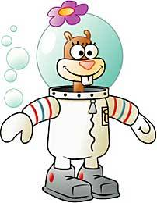
Read the information below and then answer the questions.
SpongeBob loves to grow flowers for his pal Sandy, who loves big, colorful flowers. He found a new brand of seeds coated with a special “booster” fertilizer that said it would produce huge flowers. He planted 5 of the new seeds in one container and 5 of the old brand of seeds in another container. He placed both containers on a sunny windowsill and watered them every day. He measured the diameter of each flower, which is shown in the chart.
Old Seeds | 10 cm | 12 cm | 14 cm | 6 cm | 8 cm
New Seeds | 8 cm | 14 cm | 10 cm | 12 cm | 16 cm
Which group was the control?
2. What is the independent variable?
3. What is the dependent variable?
4. What is the average diameter for each group?
5. Which seeds are the best for big flowers?

Slide 31
Read the information below and then answer the questions.
SpongeBob loves to grow flowers for his pal Sandy, who loves big, colorful flowers. He found a new brand of seeds coated with a special “booster” fertilizer that said it would produce huge flowers. He planted 5 of the new seeds in one container and 5 of the old brand of seeds in another container. He placed both containers on a sunny windowsill and watered them every day. He measured the diameter of each flower, which is shown in the chart.
Old Seeds | 10 cm | 12 cm | 14 cm | 6 cm | 8 cm
New Seeds | 8 cm | 14 cm | 10 cm | 12 cm | 16 cm
Which group was the control?
The seeds without the booster fertilizer
2. What is the independent variable?
Booster fertilizer on the new seeds
3. What is the dependent variable?
Size or diameter of the flower
4. What is the average diameter for each group?
Old = 10 cm, New = 12 cm
5. Which seeds are the best for big flowers?
New seeds w/ the booster

Slide 32
You have been assigned to design an experiment to determine the effects of light on the growth of tomato plants. In your experimental design be sure to:
State one hypothesis to be tested
Identify the independent variable in the experiment
Describe the type of data to be collected
Describe how the experimental group should be treated differently than the control group

